Slide 1

Web Hosting
Front End Design & Development

Slide 2

Recap – The Wider Web
Up to this point …
The course has focused on building web applications in a development environment
Rationale - we need to learn how to code & build good UI & UX as this is generally the biggest barrier to entry for web development
Moreover hosting, in particular on cloud platforms, are designed with many user-friendly services & documentation to assist with deployment & maintaining the server
Leaping into Production & DevOps
Despite this, we need to practice our production skills by experiencing hosting together
We can cure any fears/concerns on how to deploy projects, as well as understand proper steps on how to load, update & maintain websites into the future
Commonly – the hardest part is CHOOSING a web host, so we will go through this!

Slide 3
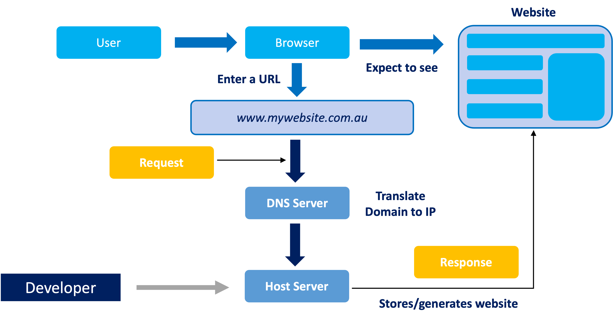
Recap – How the Web Works

Slide 4





Recap - Domain Name System (DNS)
Domain Registrar
Visitor
DNS Server(s)
Web Host
mywebsite.com.au
IP: 157.234.14.321

Slide 5


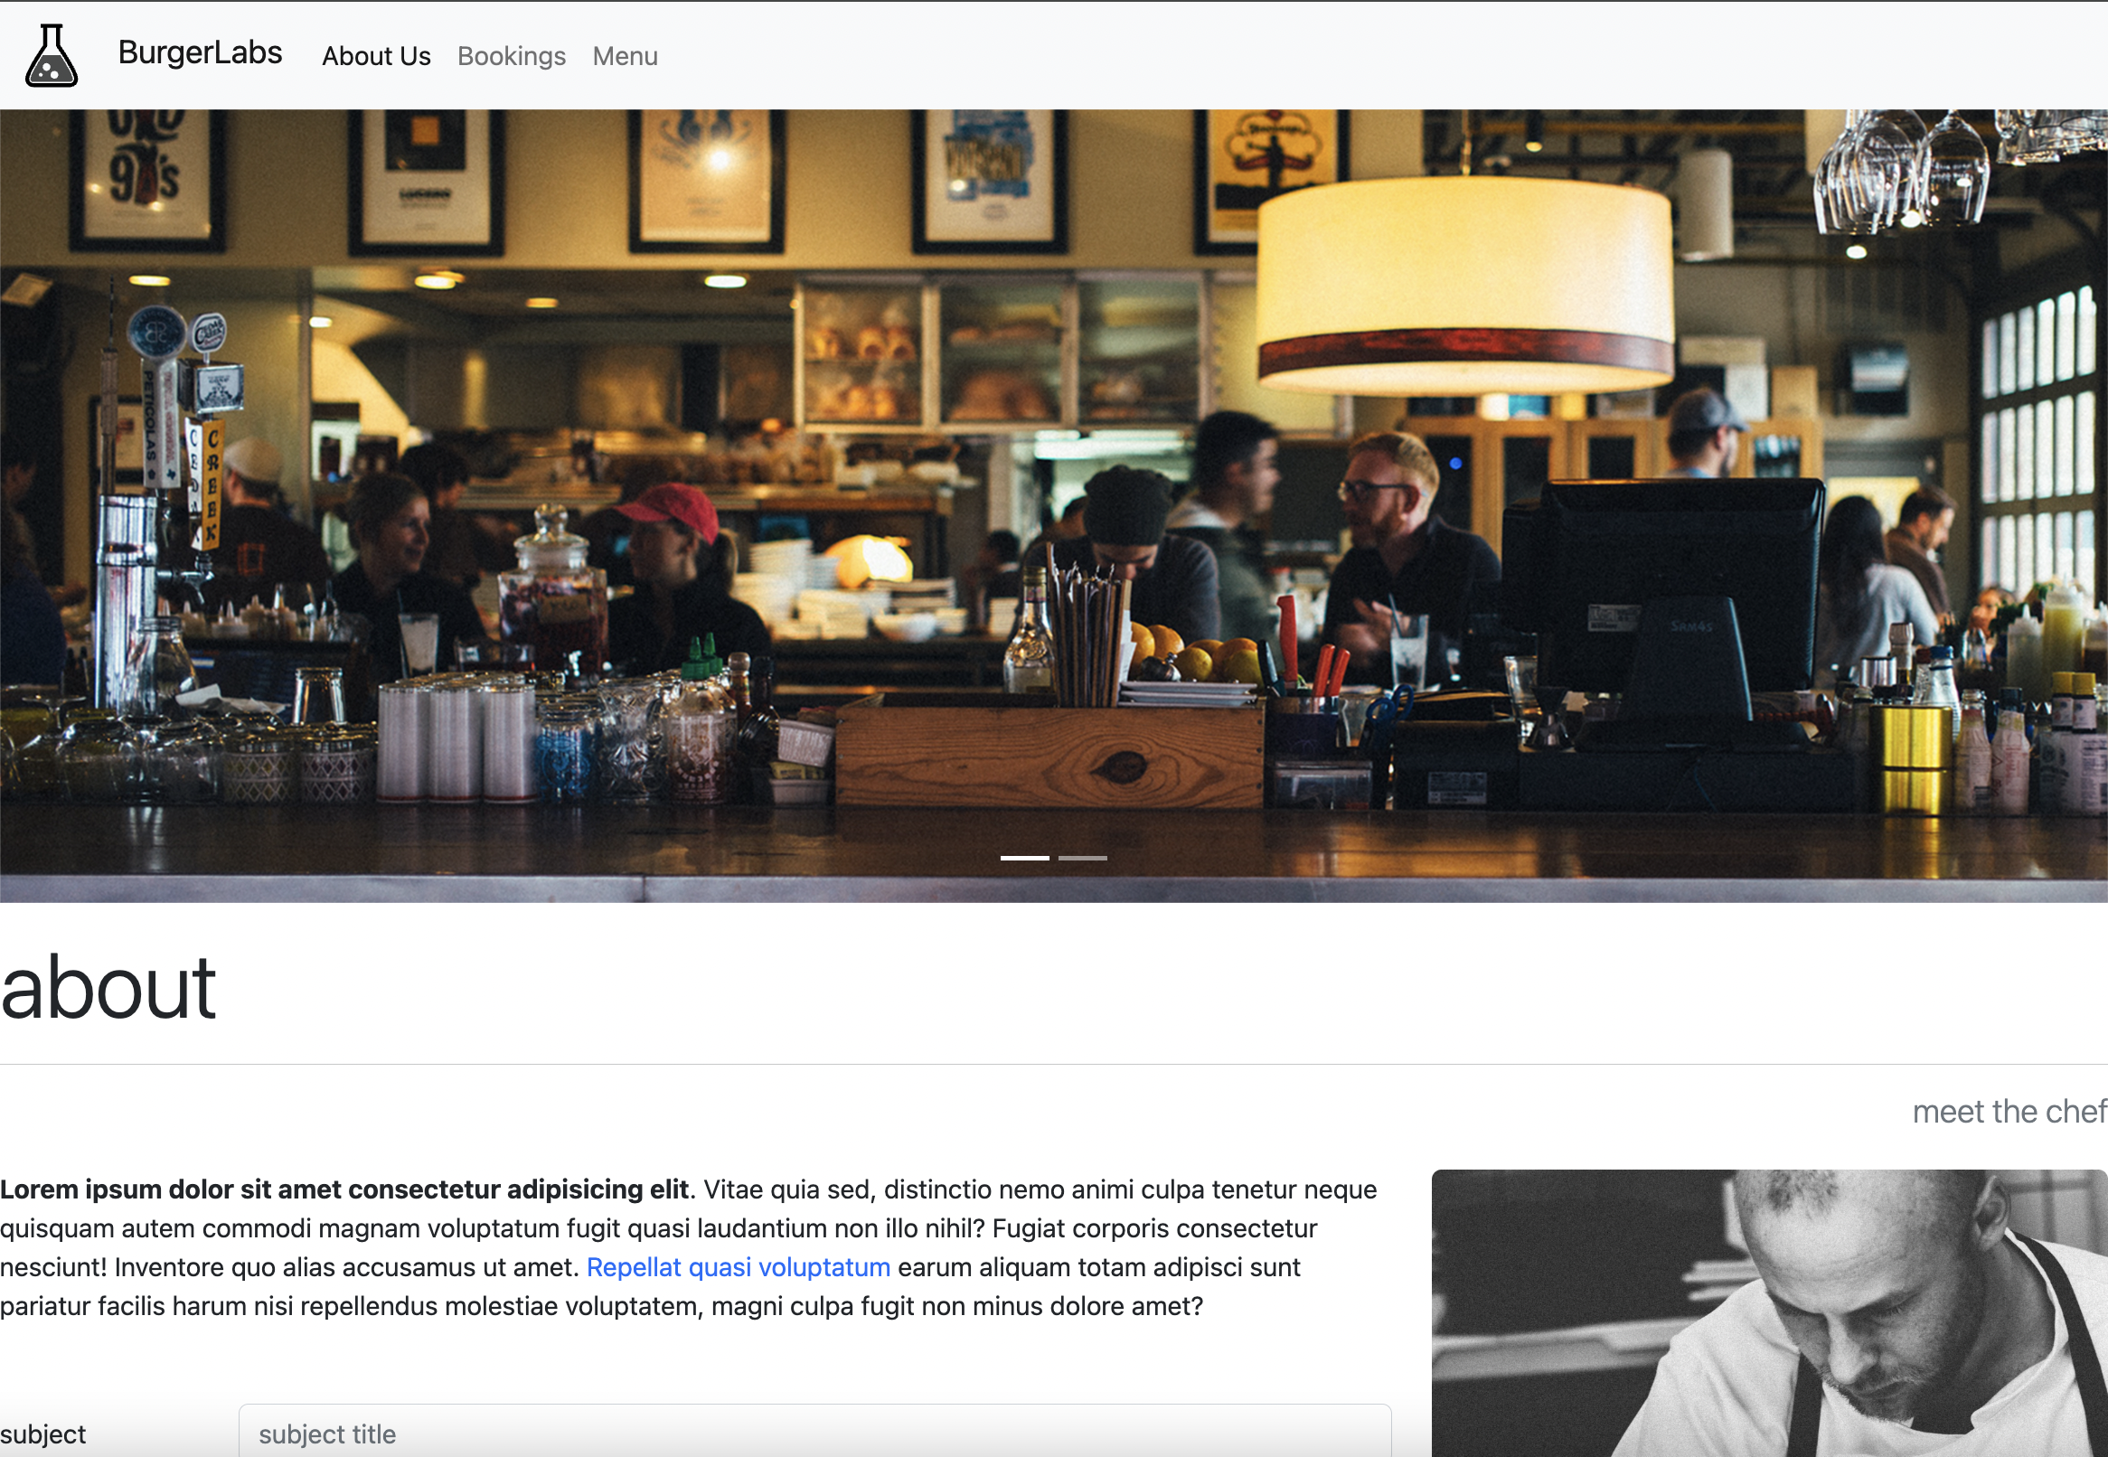
Recap – Public Website Process
Connection
Local Client
Web Host Server
Run on Desktop
Runs on Remote Server
Upload Files
Download Files
Local Client
Web Host Server
Run on Desktop
Runs on Remote Server
Public Browser
Desktop, Mobile, Tablet
Web Host Server
Runs on Remote Server
Public Browser
Desktop, Mobile, Tablet

Slide 6
Evaluating a Web Host

Slide 7

Live Website – Core Requirements
THE WEBSITE
The house
At minimum, there are generally three aspects to look for when determining an early web host:
Web Hosting Space – allotment on a remote HD for website files & connections to it
Domain Name – a string of text that maps to an IP address, to access a website via browser
SSL Certificate – “Secure Socket Layer” certificate is a digital document that authenticates the identity of a website & its origin, prevents spoof/phishing domains & allows HTTPS
Of the above – Web Hosting Space is typically the area that requires the most thought AND offers the most customisation
We need to go deeper
DOMAIN
The address
SSL
The fence
😎
HOSTING
The land

Slide 8

Hosting Step 1: The Website Build
STEP ONE: Understand your build, your website “type” & required technologies
Build type – Website remains same to all visitors OR adapts based on server requests?
Static build: Website does not make dynamic data fetch calls and is largely the same for all users. Most cases = like most our HTML, CSS & JavaScript websites!
Dynamic build: Website makes requests to server-side API to mutate the pages based on user requests. Typically involves server-side technologies like a server frameworks (Node.js) or databases (MySQL)
Technologies – Common web technologies OR specific language requirements
Front end technologies – HTML, CSS & JavaScript
Server-side technologies – PHP, C#, Python, Ruby, JavaScript (with Node.js)
Database technologies – MySQL, PostgreSQL, SQLite, MongoDB

Slide 9

Hosting Step 2: Services Offered
STEP TWO: What does the website offer as part of its overall package?
Languages supported – web hosts never offer “everything”, typically most run Linux as O/S, but then choose specific languages & technology combinations
Static or Dynamic hosting – web hosts can offer either or both, depending on their setup. Several cloud hosts only provide static, as part of a “serverless” strategy (Cloudflare Pages, Netlify, Google Firebase)
Other services offered – this can show a web hosts flexibility:
Database hosting - typically these are rarely free. Most shared servers typically offer at least one or two SQL-based databases
*Email services – typically shared hosts offer email services, cloud do not as external providers typically are more popular than shared email gateways
Website monitoring – does the host provide automatic analytics on traffic & performance. This is mixed between shared & cloud – keep an eye out!
Customer support – often a big reason why people still use shared, as cloud hosts typically outsource support to documentation (can even include custom installations like WordPress)

Slide 10

Hosting Step 3: Plans Offered
STEP THREE: What is the cost of hosting & what changes based on payment?
Shared Hosting
Often have number of plans that range in price – base plans typically begin from around $70-80 per year
Higher paid plans typically offer more website slots, email addresses, SSD storage space, bandwidth as well as other options like free SSLs, “free” domains (bundled) & other perks
CARE – typically shared hosts like to charge a low fee on 1st year and gradually SQUEEZE the price up once your all setup on their servers ~ very cunning!
Cloud Hosting
Typically have a free hosting tier (“spark plan”, “hobby option”, etc.)
These plans provide a decent amount of cloud storage (always check), bandwidth & free staging domains (“www.yoursite.vercel.app”), but not much else
CARE – cloud hosts use sharp variable pricing, if your site goes beyond the free tier limits!

Slide 11

Final Hosting Considerations
EMAIL SERVICES
Shared server –if you pay their plan, it will typically give access to cPanel email services or even dedicated email hosting.
Cloud server – these typically do not offer embedded email services, largely as there are several very popular cloud/external email hosting providers such as Microsoft 365, Google Workspace, Zoho Mail, Dreamhost & so on. These are paid services, but provide a lot of flexibility
SERVER SPECIALISATIONS
Note there are host options beyond shared & cloud (although these are typically lowest cost & easiest to understand).
Virtual Private Server / Dedicated Server – both are similar, each one you have basically your own hosting space to yourself. VPS is a virtual machine created from a physical server. DS is a physical machine without this virtualisation layer. VPS is more flexible!
Managed Hosting – Hosting where “control services” are enabled. You still have a hosting space, but you basically pay a premium for the web host to manage those hosting systems on your behalf, including maintenance and updates (think WordPress hosts like Bluehost)

Slide 12
Deployment Workshop

Slide 13

Shared Server (GoDaddy)
SUMMARY: Shared servers, like GoDaddy, HostPapa or VentraIP, offer a more traditional but equally as acceptable solution for hosting
ADVANTAGES
Good scaling & customisation for small to medium level applications
Wide and flexible services offered for the lowest plans, including email, database, server language & multi-language support
Good bundle deals can include hosting space + domain + SSL in one deal for less the $100 p.a. (although can “ratchet-up” per year)
DISADVANTAGES
No free plans
Can be vulnerable to traffic spikes on the server, by other shared apps
Updating deployed builds is manually conducted for each update, via FTP (no Git integration)

Slide 14

Cloud Host 1 (GitHub Pages)
SUMMARY: Github Pages allows hosting of ONE static website from a “main” Github repository
ADVANTAGES
Popular & free hosting service, used by a range of developers
Being built out of a central repository, means if you understand .git & GitHub – it is an easy leap
Allows for seamless updating via repo pushes
DISADVANTAGES
Limited to ONE domain, unless you use “GitHub Actions”, which are tricky to use & clunky
Seen by some as “semi-professional”, as more of a hobby site
.git & GitHub is not intuitive to beginners – so can be a significant barrier to using the service

Slide 15
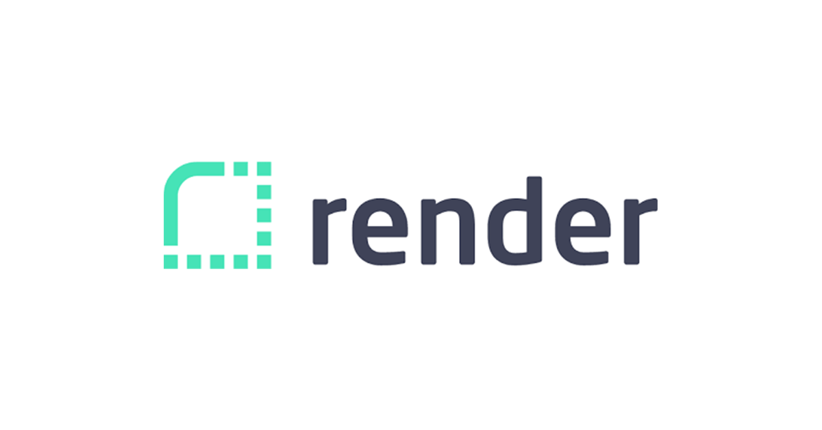
Cloud Host 2 (Render)
SUMMARY: Render allows for the cloud hosting of static AND full stack applications, including all the services in between.
ADVANTAGES
Similar to Cloudflare Pages, its Dashboard is clear and organised in a project-by-project approach
The services offering is extremely flexible - you can host a static front-end SPA, RESTful APIs, databases like PostgreSQL, custom Dockerfiles, and many different frameworks/languages = most free
Offers GitHub syncing - allowing seamless updating & uploading
DISADVANTAGES
Has expensive plans, if your usage goes beyond free limits
Can be tricky to setup a full stack, requiring a “mix” of their dashboard services

Slide 16

Cloud Host 3 (Cloudflare Pages)
SUMMARY: Deploys front-end applications (basically “static”) via published GitHub repos
ADVANTAGES
Allows for use of personal domain with domain purchasing available
Competitive free tier vs. Netlify & Render (including free analytics)
Can either do direct upload OR via GitHub syncing = flexible!
Backed by strong global infrastructure network
DISADVANTAGES
The websites typically have a lag when first uploading/updating
Whilst excellent, the dev dashboard to manage the hosted applications can be confusing at first
Like Netlify/Render – if usage exceeds limits, can become expensive

Slide 17

Which webhost for my portfolio?
This stage will be up to YOU!
The examples shown have been to “de-mystify” the process of deployment options
Assessment 2, Part 5 (Milestone 3) – requires you to analyse & evaluate at least three web hosts in detail. You now could complete parts of this analysis & use any combination of the webhosts shown
On analysis, pick ONE of the options – that works best for your “developer style” and what you think will offer your portfolio the best services
You COULD also go off the path altogether and look to other hosts. Recommended other static hosts could include:
Other Shared Servers: HostPapa & VentraIP are both good local webhosts
Other Static Cloud Hosts: Netlify & Vercel are extremely popular & easy to use

